Slide 1

Retail & Marketing for Customer Segmentation
Data Analysis - Report
Samia Nadeem

Slide 2
Business Problem
The European Fashion Store is a growing online fashion retailer operating across multiple European markets, but it currently lacks a clear, data‑driven understanding of its customers, sales performance, and marketing effectiveness. Despite steady website traffic and a broad product catalog, management has observed inconsistent revenue growth, fluctuating repeat purchase behaviour, and uncertainty about which customer segments and products truly drive long‑term value.
At the same time, marketing spend on digital campaigns and promotions has increased, yet it is unclear which channels, campaigns, or customer groups generate the highest return on investment, and where in the purchase journey potential customers are dropping off. Without a unified view that connects transactions, customers, and basic marketing behaviour, the business cannot confidently design targeted offers, prioritize high‑value segments, or define a focused growth strategy.

Slide 3
Problems
Revenue growth unstable.
Repeat customers aren’t clear.
Marketing spends ROI unclear.

Slide 4
Goals
Achieve steady revenue growth
Increase online sales consistently over time by improving monthly revenue and revenue growth percentage.
Build strong customer loyalty
Bring customers back more often by increasing repeat purchase rate, retention rate, and customer lifetime value.
Make marketing spend more efficient
Optimize digital marketing channels and campaigns so that ROAS increases, CAC decreases, and budget is focused on the most profitable channels.

Slide 5
KPI’S (Key Performance Indicators )
Total Revenue (monthly).
Revenue Growth % (MoM ).
Repeat Purchase Rate vs One-time Buyer.
Average Order Value (AOV).
Retention Rate/Churn Rate.
RFM‑based customer segments
Campaign / Channel performance

Slide 6
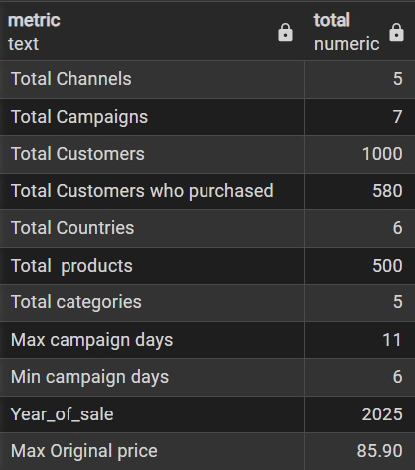
Exploratory Data Analysis
“The dataset covers 1,000 customers across 6 European countries, of which 580 made at least one purchase over a 3‑month period in 2025. It includes around 500 products across 5 categories, with original prices up to 85.9, and captures marketing activity across 5 channels and 7 campaigns, each running between 6 and 11 days.”

Slide 7
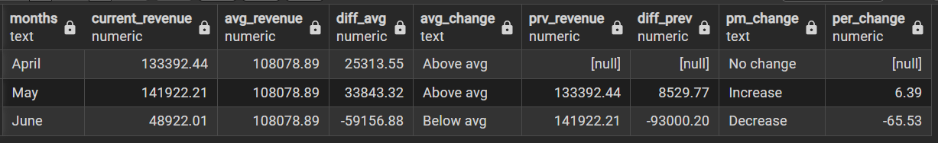
Which month performed best, and why?
May is the best‑performing month, with revenue growing about 6% vs April and both total revenue and number of orders higher than in April and June.
This uplift is driven by T‑shirts, Dresses and Shoes contributing roughly 64% of overall revenue, plus strong demand from Germany (23.5%) and France (22.5%) mainly via E‑commerce (53.8%) and the mobile app (46.2%).
This combination of strong core categories, core markets and core channels explains why May clearly outperforms April and June.

Slide 8
Why does revenue drop so much in June?
In June, total revenue drops sharply, by around 65.5% compared to May, even though some areas still grow. Shoes become the top category in June and France’s share increases from 22.5% to 25.3%, while the App channel’s share rises from 46.2% to about 47.5%.
However, these gains are not enough to offset the decline in our largest revenue drivers. T‑shirt sales, our top category overall, fall in June, Germany’s revenue share slips from 23.5% to 22.7%, and E‑commerce, our main channel, loses share from 53.8% to 52.5%.
Moreover, no campaigns ran in June, and the 30% May discount was not repeated, which may have reduced sales.
Because the biggest drops hit the biggest contributors, overall revenue declines heavily despite growth in smaller pockets.

Slide 9
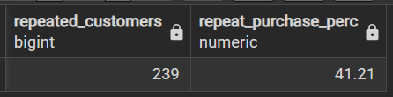
How many customers are actually loyal?
Out of 1,000 total customers, only 580 made at least one purchase, and just 41% of purchasing customers are repeat buyers while 59% buy only once.
This shows that more than half of the acquired customers do not return, so there is a big opportunity to improve loyalty and get more value from existing acquisition spend.

Slide 10
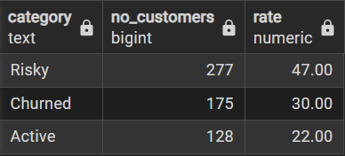
What is our overall retention and churn situation?
Among all purchasing customers, 22% are Active, 47% are At‑risk and 30% are already Churned.
This means almost half the relationship base is close to churning and one‑third is lost, so focused retention and win‑back are critical to protect future revenue.

Slide 11
Who are our high‑value customers?
RFM segmentation identifies 90 High_value customers and 424 Medium customers, and within High_value, 60 are Active while 30 are At‑risk (all last purchased in May).
A significant share of our most valuable customers is therefore slipping into risk, making them a top‑priority target for win‑back campaigns, while Active High_value customers should receive ongoing loyalty treatment to protect core revenue.

Slide 12
How can we use the Medium segment to drive future growth?
The Medium segment is our largest group, with 424 customers, including 68 who are still Active.
These moderately engaged buyers are a strong growth lever and should be nudged with light, personalized cross‑sell and upsell offers, especially before any of them slip into the At‑risk bucket.

Slide 13
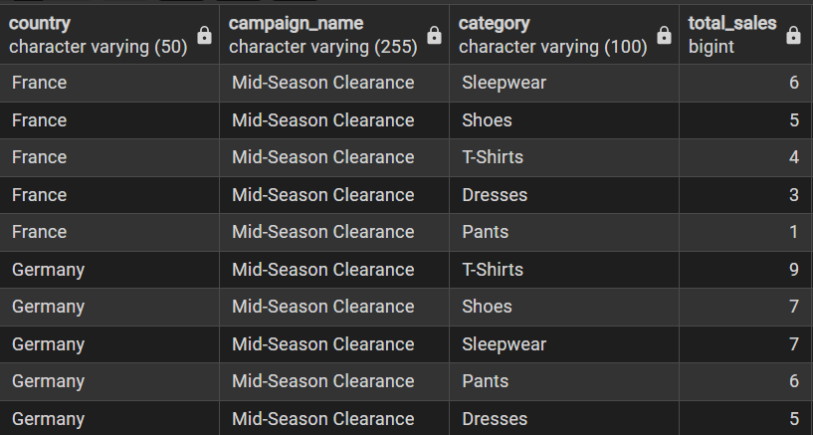
How effective were our campaigns?
After further investigation of campaign performance, it can be seen that only the May Mid‑Season Clearance campaign actually generated incremental campaign‑day sales.
While the April “Easter Promotion” and June “Early Summer Deal/June Price Drop” ran with no recorded campaign‑day sales at all.
RECOMMENDATION:
Relying on blanket 30% discounts risks over‑discounting; instead, campaign strategy should prioritize focused offers on High_value and Medium segments, improve timing and channel selection, and test smaller, smarter discounts rather than repeating broad 30% cuts.

Slide 14
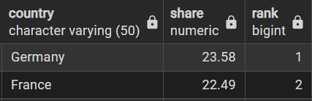
Which countries should be prioritized for future growth?
Overall sales and revenue are heavily concentrated in France and Germany, while all six countries do have High_value customers but Spain has the lowest High_value base.
For future growth, France and Germany should remain the primary focus markets, while Spain should be treated as a longer‑term build market with smaller, test‑and‑learn initiatives to gradually grow its High_value and Medium customers without over‑investing too early.

Slide 15
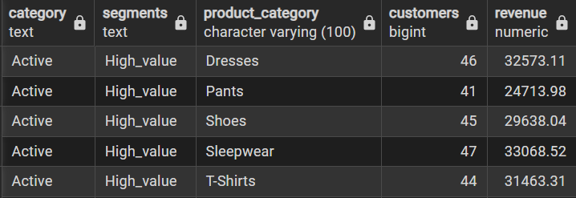
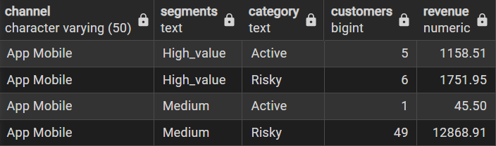
Make marketing spend more efficient
To make marketing spend more efficient, budget should be concentrated on our strongest countries (especially France and Germany), core fashion categories such as T‑shirts, Dresses and Shoes (which together contribute about 64% of overall revenue), and they primarily purchase through the Mobile App and Mid-Season Clearance Campaign, so these categories and channels should be the main focus for loyalty offers and win‑back actions targeting this segment.

